Slide 1

CALVIN Winter 2024 Workshop
Mustafa Dogan
Center for Watershed Sciences
January 12, 2024
msdogan@ucdavis.edu
GitHub repo: https://github.com/msdogan/CALVIN-shortcourse

Slide 2
California’s water system
California has an extensive intertied water supply system
Supply-demand mismatch (spatiotemporal)
Water is mostly available in northern CA and Sierras
Agricultural demand in the Central Valley
Urban and industrial demands in the Bay area and southern CA
Reservoirs and canals were built to meet these demands in time and space

Slide 3
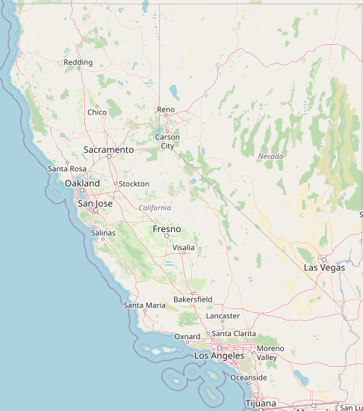
Water demand
Agricultural water demand mostly in the Central Valley
Urban demand mostly in the Bay area and southern CA
Environmental demands
Wildlife refuge
Minimum instream flow
Required Delta outflow

Slide 4
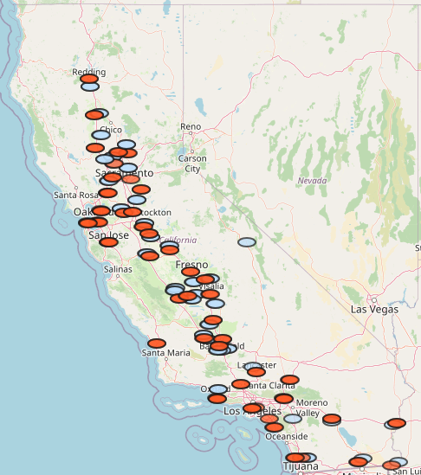
Ag and urban demands
Urban demand
Aggregated demand areas
In CA, 70% of water is used by ag and 30% for urban
Urban demand
Interior house
Exterior house
Industrial
Agricultural demand

Slide 5
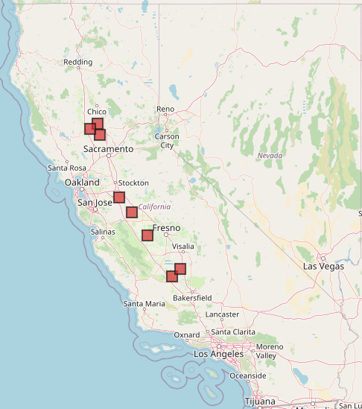
Environmental demand
Wildlife refuge demands
Aggregated demand areas
Mainly surface diversions
Minimum instream flow requirements
Required Delta outflow
Sacramento NWR
Gray Lodge NWR
Sutter NWR
San Joaquin West NWR and WMA
San Joaquin East NWR and WMA
Mendota WMA
Kern NWR
Pixley NWR

Slide 6
Main surface water sources
Trinity River
CA’s main surface water sources:
Trinity River (exports)
Sacramento River
Feather River
Yuba River
American River
San Joaquin River
Calaveras River
Tuolumne River
Merced River
Kings & Kern Rivers
Colorado River (exports)
Sacramento River
San Joaquin River
Kings & Kern Rivers
Colorado River

Slide 7
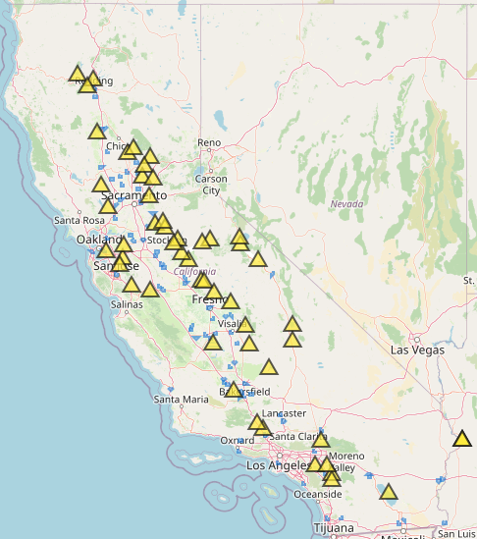
Major surface reservoirs
Trinity Lake
Shasta
Store water to meet urban, agricultural and environmental demands
Provide flood control
Generate hydropower
Provide recreational space
Oroville
N. Bullards Bar
Folsom
N. Melones
N. Don Pedro
Millerton
San Luis

Slide 8
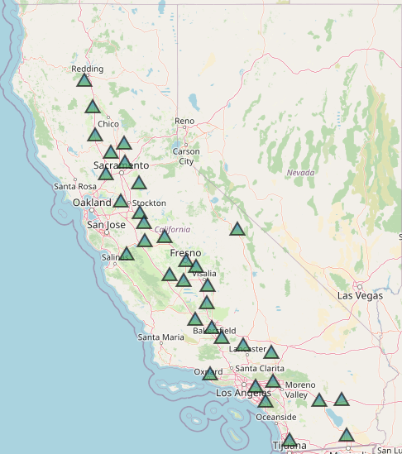
Main groundwater sources
Central Valley aquifer (big)
21 subbasins
Southern California subbasins (small)
Some urban communities depend solely on groundwater
Major buffer in drought years for agricultural users
Groundwater subbasin
Central Valley Aquifer

Slide 9
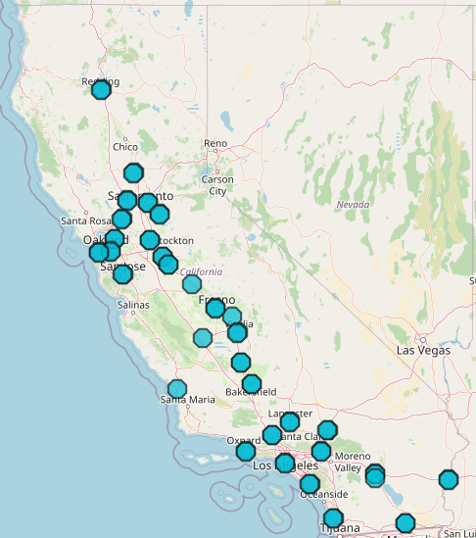
Nonconventional sources
Wastewater treatment plant
On-site reuse (agricultural)
Wastewater treatment (nonpotable)
Desalination
High cost of treatment (nonpotable and desalination)

Slide 10
Water conveyance
Clear Creek Tunnel
Mainly for urban water supply:
California Aqueduct
Mokelumne Aqueduct
Hetch Hetchy Aqueduct
Los Angeles Aqueduct
Colorado R. Aqueduct
Mainly for agricultural water supply:
Delta Mendota Canal
Tehama Colusa Canal
Friant-Kern Canal
All American Canal
Tehama-Colusa Canal
Mokelumne Aqueduct
Hetch Hetchy Aqueduct
Delta-Mendota Canal
Friant-Kern Canal
LA Aqueduct
California Aqueduct
Colorado R. Aqueduct
All American Canal

Slide 11
Management issues
Water demand > water supply
Worsened by nonstationary climate and frequent droughts
Environmental issues, endangered species
Aging water system (mostly built 1920-1950)
Groundwater overdraft
Declining gw levels
Land subsidence
High pumping costs
Unsustainable use of resources
SGMA (2014) to restore gw

Slide 12
Water management
Given water supply instruments (surface reservoirs, canals, aqueducts, groundwater pumping, water treatment etc.)
Given water demands (agricultural, urban and environmental)
Given management issues
How to better manage California’s extensive water supply system?
How to efficiently allocate limited water among different users?

Slide 13
Hydroeconomic modeling
Combines water resources systems & economics
Allocates water among different users
Water allocations are driven by economic value of water
Economic costs & benefits are constrained by hydrology (water availability) & policies

Slide 14
Hydroeconomic modeling
Useful for
Represents regional scale hydrologic, engineering and economic aspects
Provide a framework for water resources systems
Solution-oriented tools for discovering new strategies
Investigates water management schemes and policy insights
Useful for water resources planning & management decisions

Slide 15
Components
Hydroeconomic models represent all major hydrologic and engineering parts of the system
Water balance components
River flows, evaporation, groundwater recharge, and return flows
Infrastructure components
Canals, reservoirs, treatment plants, surface and ground water pumping, and artificial recharge
Water demands (agricultural, urban, and environmental), operating costs, and operating rules

Slide 16
Why an economical approach?
Water is a scarce source
Should be managed and allocated efficiently
Economics offers methods to evaluate equity and efficiency
Water has a value as a:
Commodity in various production processes
Diluter and transporter of waste
Recreational space
Ecological habitat

Slide 17
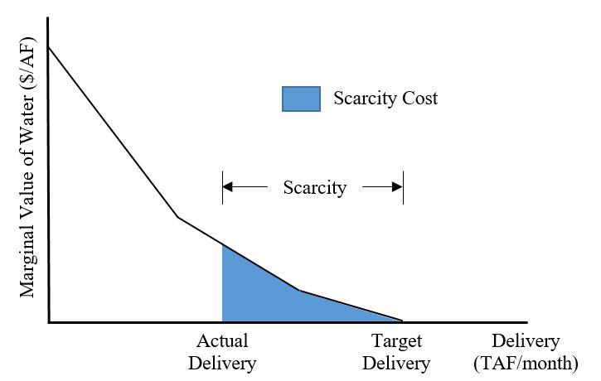
Economic Value of water
Demand Function
Cost (or Penalty) K$
Unit Price of Water ($/AF)
Scarcity Cost
Scarcity
Market Value
Actual Delivery
Target Delivery
Delivery (TAF/month)
Strictly piecewise linear convex curves guarantee global optimum

Slide 18
Formulation and design
Hydro-economic models use simulation and optimization separately or together.
Simulation (What if?)
Simulate decisions on a time-step
Based on operating rules
More detailed
Optimization (What is best?)
Objective function (minimize costs, maximize benefits)
Physical and management constraints
More generic

Slide 19
Applications
Infrastructure planning and operation
Capacity expansion
Conjunctive use management (surface and ground water)
Water allocation and market
Adaptation (climate change)
Collaboration for conflict resolution
Design of institutional policies (water rights, flow requirements, no groundwater overdraft)

Slide 20
Limitations
Simplification and aggregation of physical, economic and regulatory processes and data
Deterministic approach (good future knowledge)
Linearization of non-linear functions
Ideal water market operations
Mathematical representation of social, environmental and political objectives

Slide 21
Overall
Hydro-economic models:
Represent engineered system, considering the economics of water demands and costs
Provide a framework for planning and operation
Increase system efficiency
Help decision-makers better operate complex water systems

Slide 22

CALVIN model
CALVIN = CAlifornia Value Integrated Network
Hydroeconomic optimization model
Economics driven water allocation operations
Optimizes deliveries to users (minimizing total operating and scarcity costs)
Represents California’s water infrastructure
Historical monthly hydrology to represent hydrologic variability (Oct. 1921 to Sep. 2003)
2050 urban and agricultural demands

Slide 23
An integrated model
CALVIN is an integrated model
Surface water & groundwater resources are used conjunctively
Aggregated environmental, agricultural & urban demands are represented
The physical system is connected via rivers, canals, aqueducts, & reservoirs
Reservoirs carry water across time-steps (multi-period model)

Slide 24
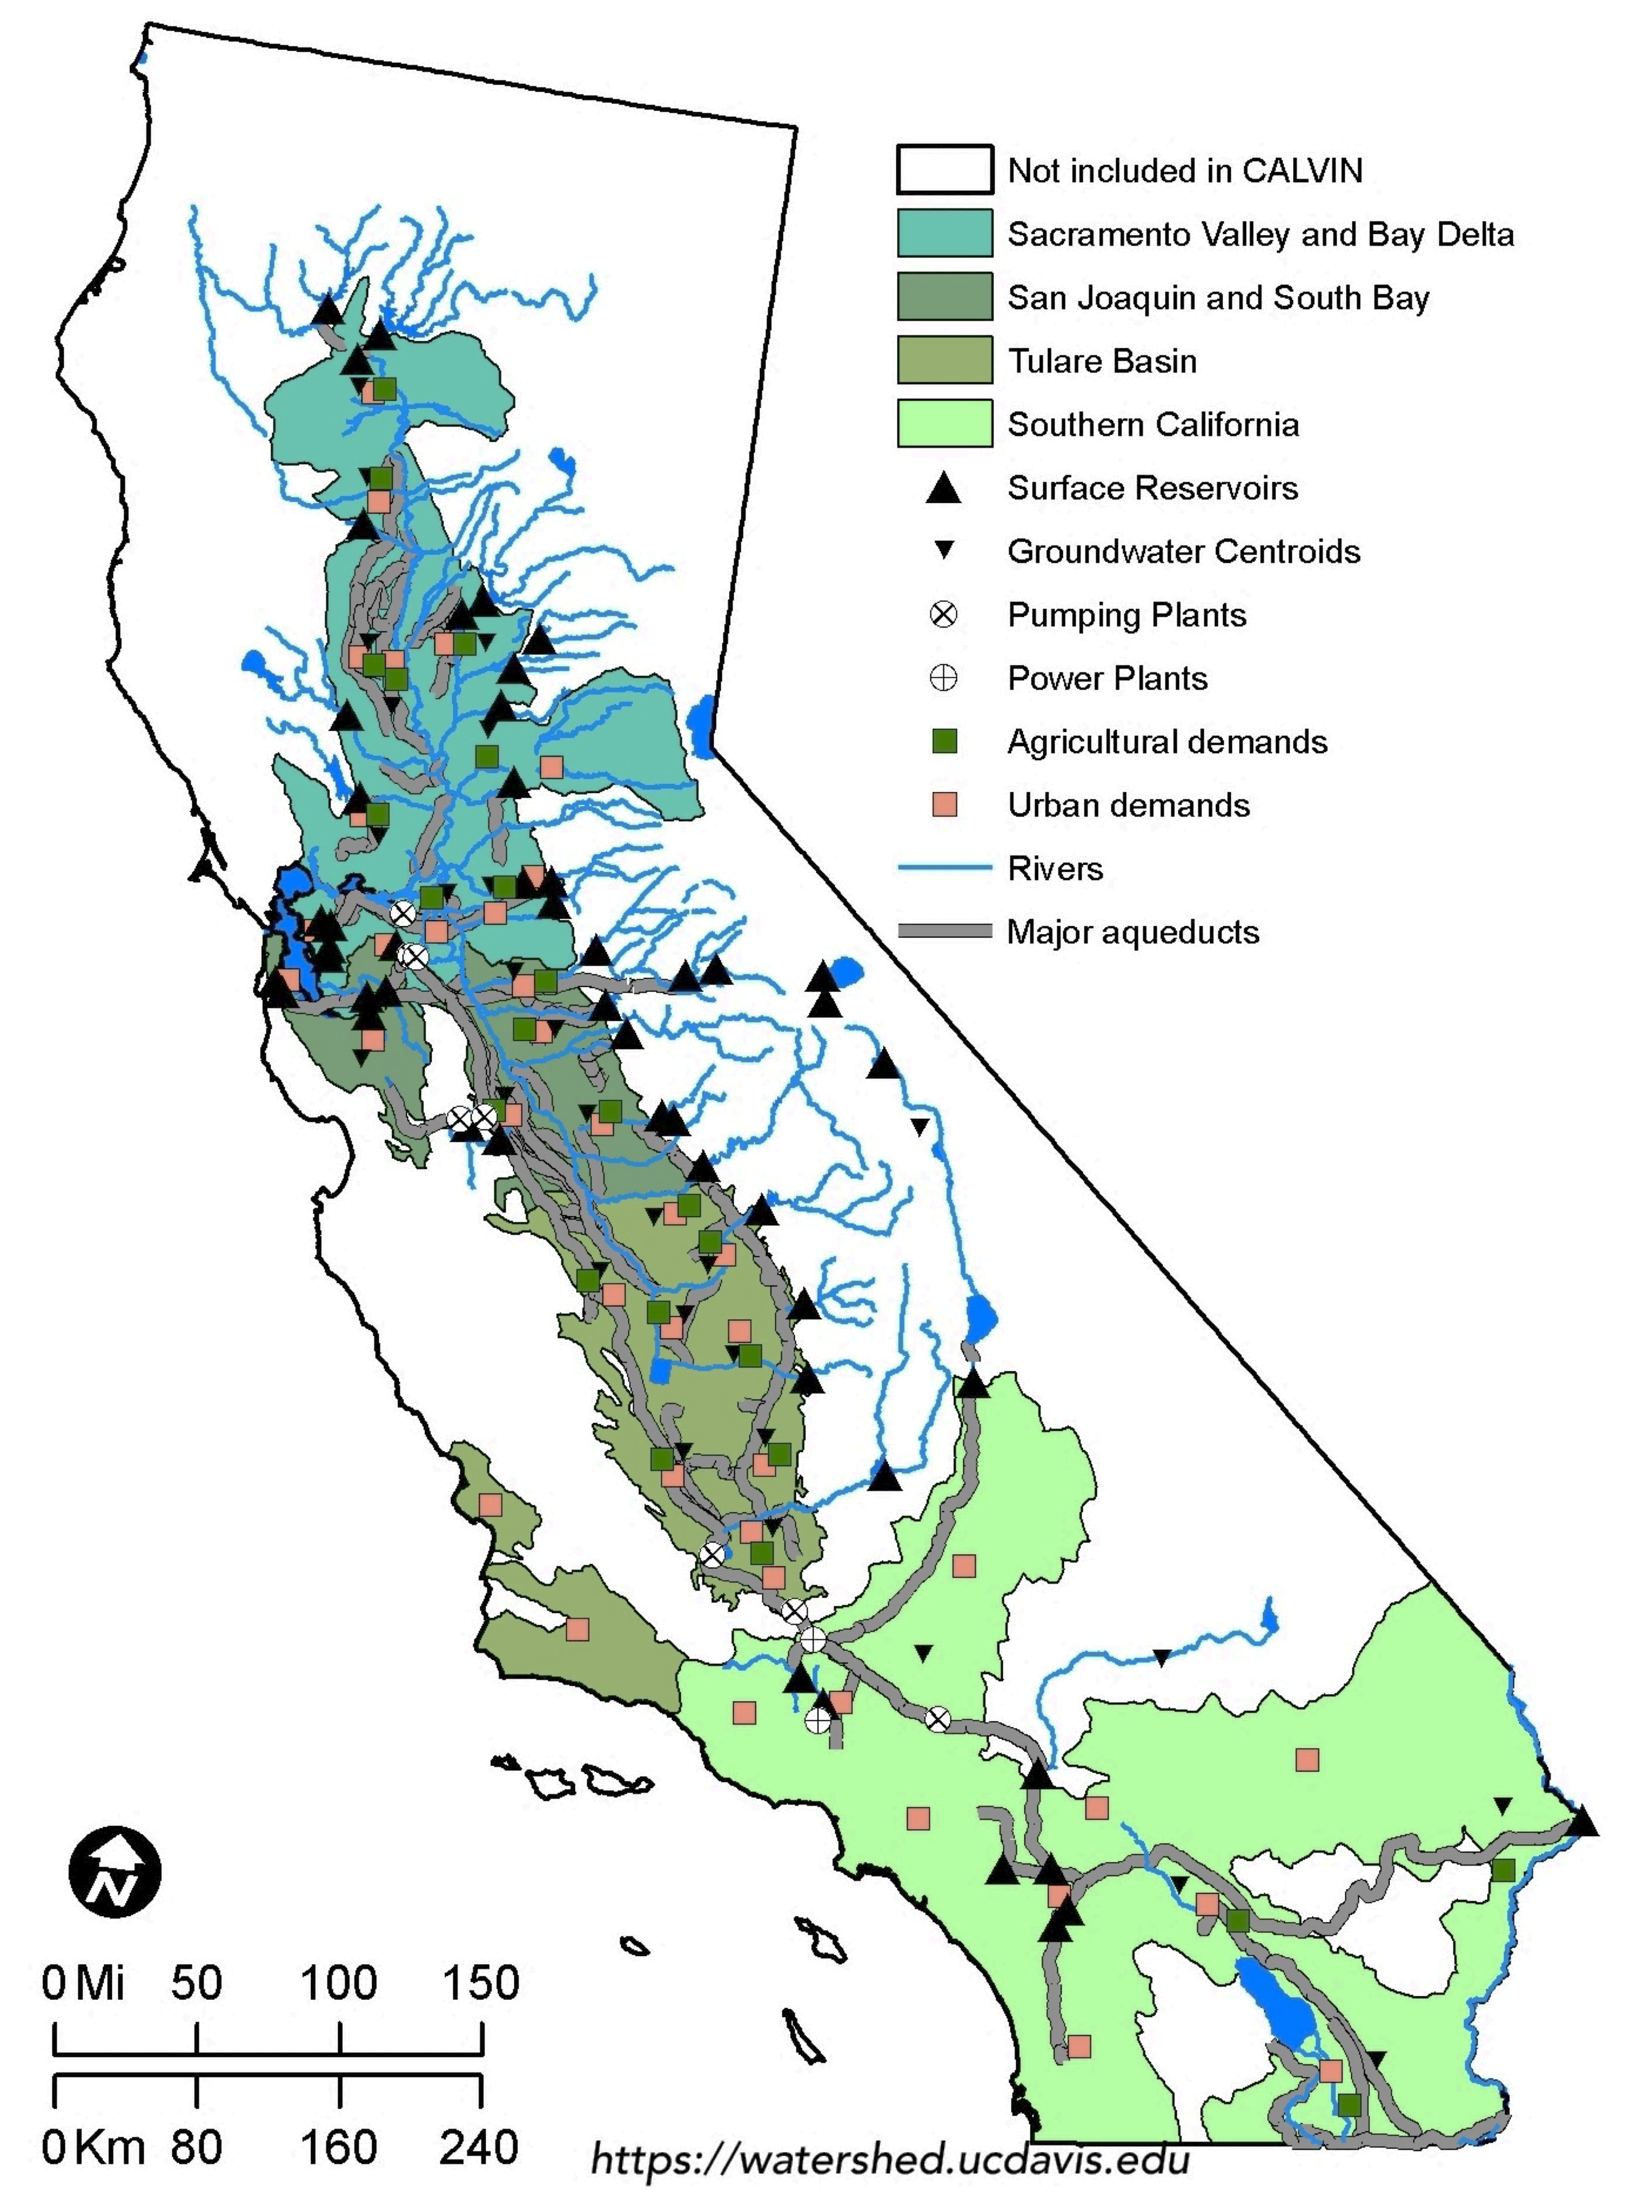
Model coverage
Most agricultural activities & urban population (~90%)
35 agricultural & 30 urban demand locations
9 wildlife refuge demands & 21 MIF requirements
33 groundwater basins, 53 surface reservoirs

Slide 25
Documentation
Appendix A | SWAP Model, Agricultural Water Values
Appendix B1 | Urban Water Values I
Appendix B2 | Urban Water Values II
Appendix C | HEC-PRM
Appendix F | Environmental Constraints
Appendix G | Operating Costs
Appendix H | Infrastructure
Appendix I | Surface Water Hydrology
Appendix J | Groundwater Hydrology
Appendix K | Irrigation Water Requirements
More information and documentation about CALVIN can be found at http://calvin.ucdavis.edu/
Also theses, dissertations and publications

Slide 26
Motivation for CALVIN
Interconnected water system
Integrated water management tools
Reservoir operations
Groundwater and conjunctive use
Water conservation
Wastewater reuse
Water markets and transfers
Can we make better sense of this integrated system?
How could system management be improved?
What is system’s reaction to changes in facilities and policies?

Slide 27
CALVIN studies
CALVIN has been used in numerous studies:
Climate change & adaptation
Groundwater overdraft
Groundwater recharge
Effects of removing a dam
Marginal value of expanding reservoir storage
Marginal value of adding/expanding infrastructure

Slide 28
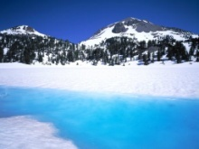
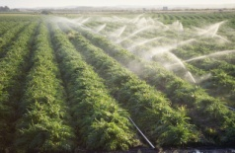
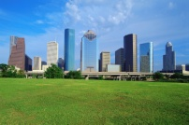
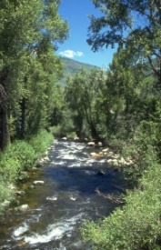
Model Components
Water sources
Rim inflows, groundwater inflows and local runoff
Demand locations
Agricultural, urban, and wildlife refuge
Conveyance infrastructure
Reservoirs, pumping facilities, and canals
Capacity constraints
Regulatory requirements
Minimum in-stream flow requirements
City A
River
Agriculture
City B
Aquifer

Slide 29
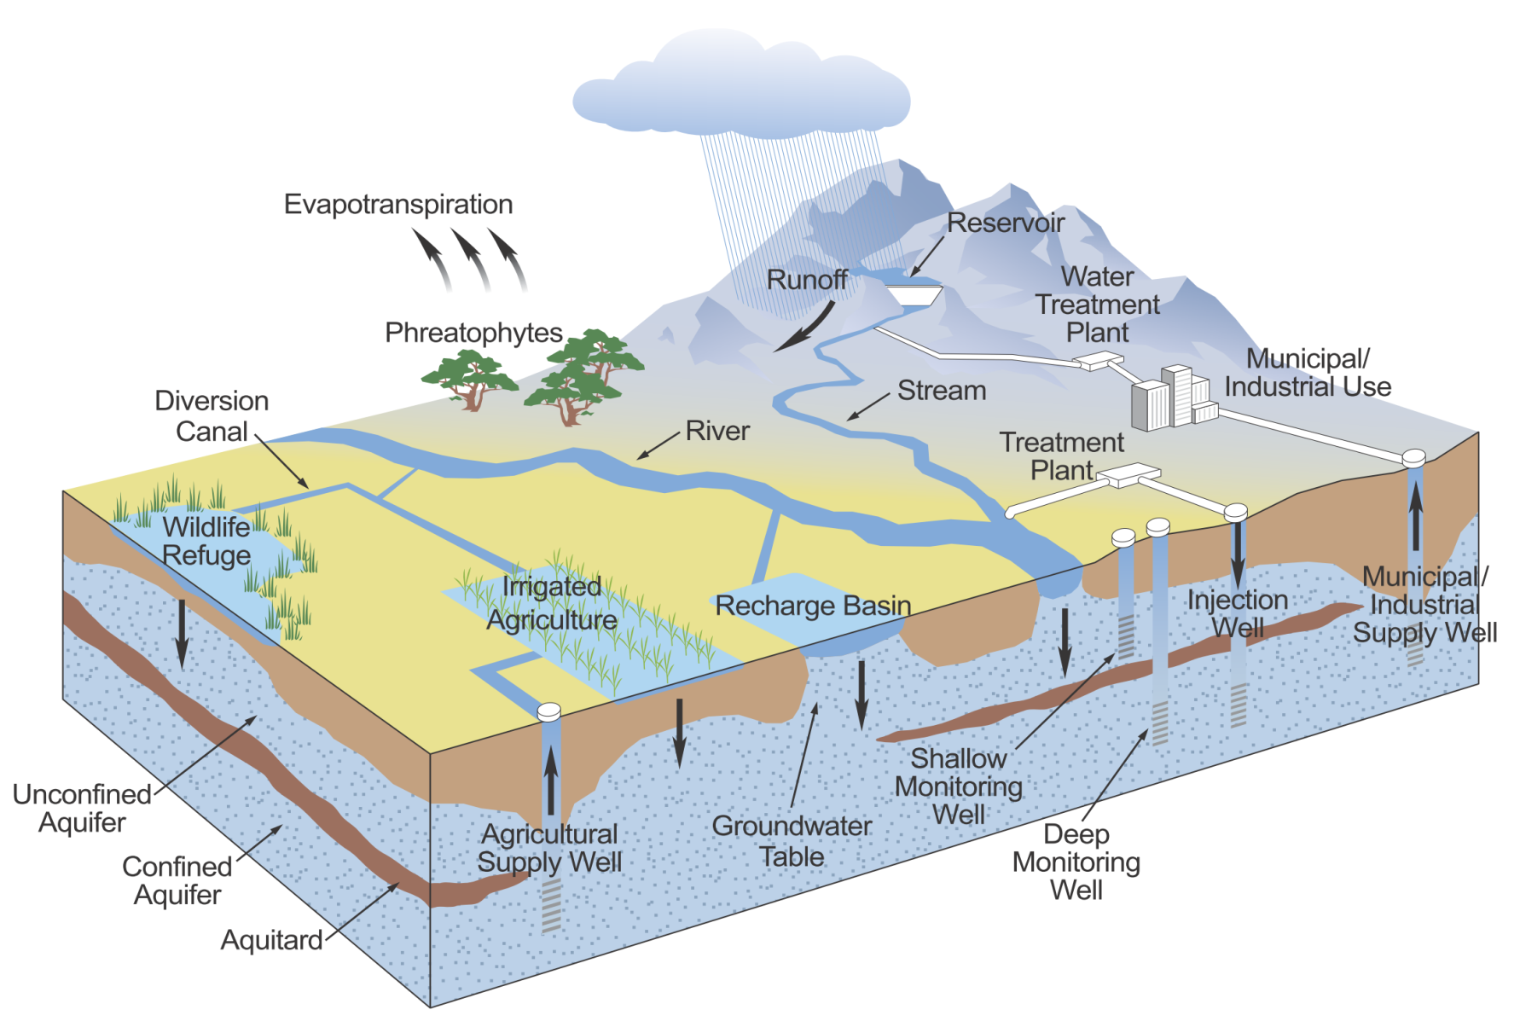
Hydrology
SEEPAGE/ EVAPORATION LOSSES
RIM INFLOWS (CalSim II)
NET RESERVOIR EVAPORATION (CalSim II)
LOCAL ACCRETIONS/ DEPLETIONS (CalSim II)
GW INFLOWS (C2VSim)

Slide 30
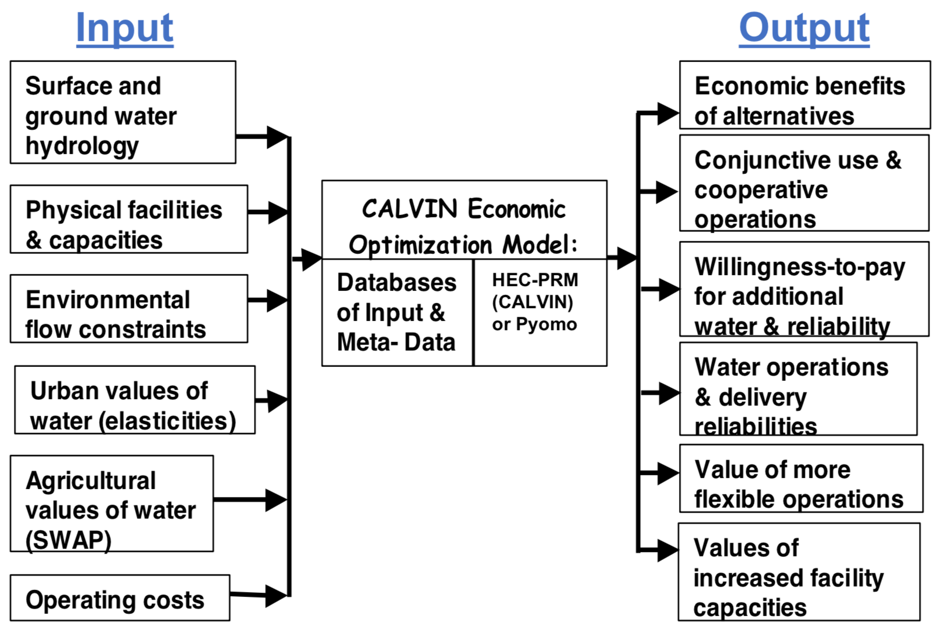
Data overflow
Water operations are driven by economic value of water: Hydrologic data + economic data

Slide 31
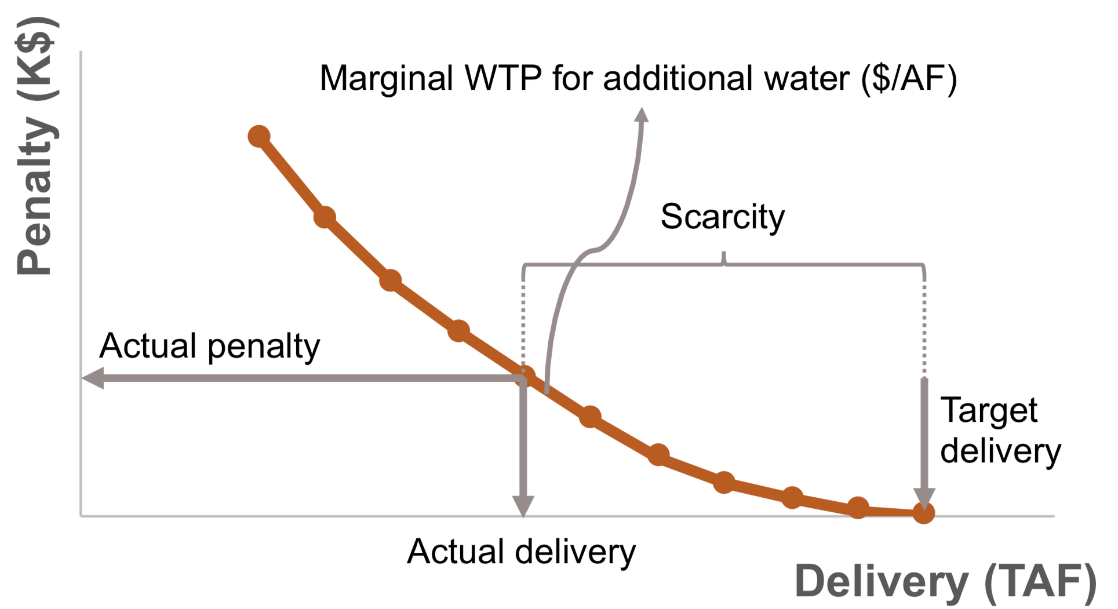
Economic value of water
Monthly varying total cost curves derive operations for agricultural & urban deliveries & hydropower
Whenever a user’s total demand (target delivery) is not met, scarcity occurs
The difference between target & actual deliveries = scarcity
The scarcity cost (penalty) is total loss due to lack of water related activities

Slide 32
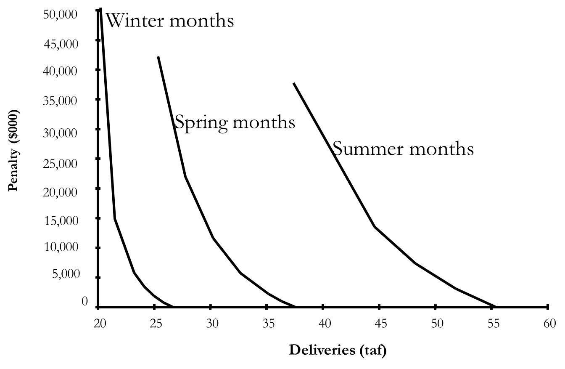
Demand curves
Agricultural demand in different seasons
Less flexibility (steeper slopes)
More flexibility (smaller slopes)

Slide 33
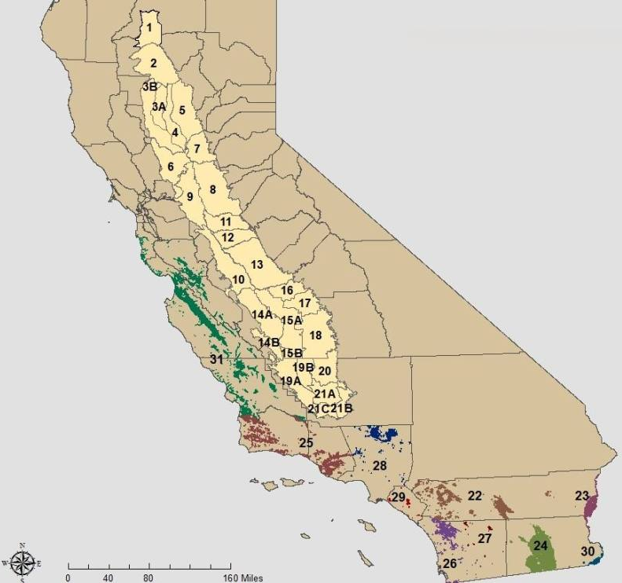
Agricultural demand
CVPM 1-21 in the Central Valley
Southern California demand locations
SWAP model is used to create penalty curves

Slide 34
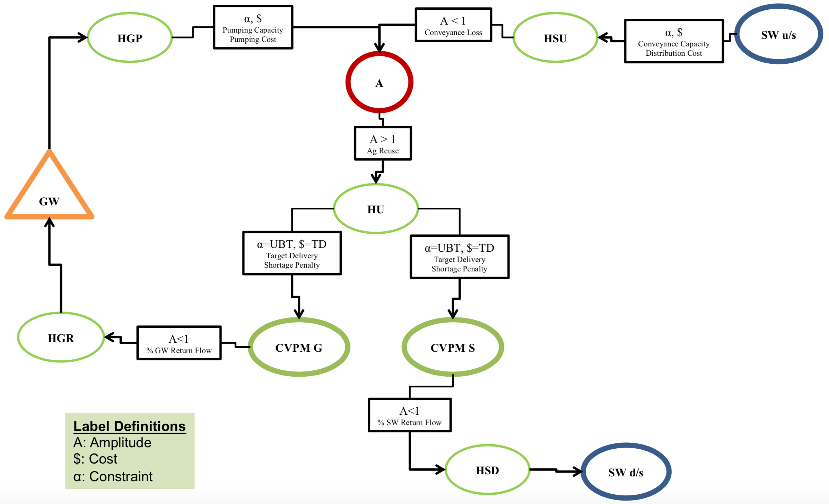
Agricultural demand
Two supply sources: groundwater & surface
Aggregated demand is divided into two parts based on return flow to groundwater or surface water

Slide 35
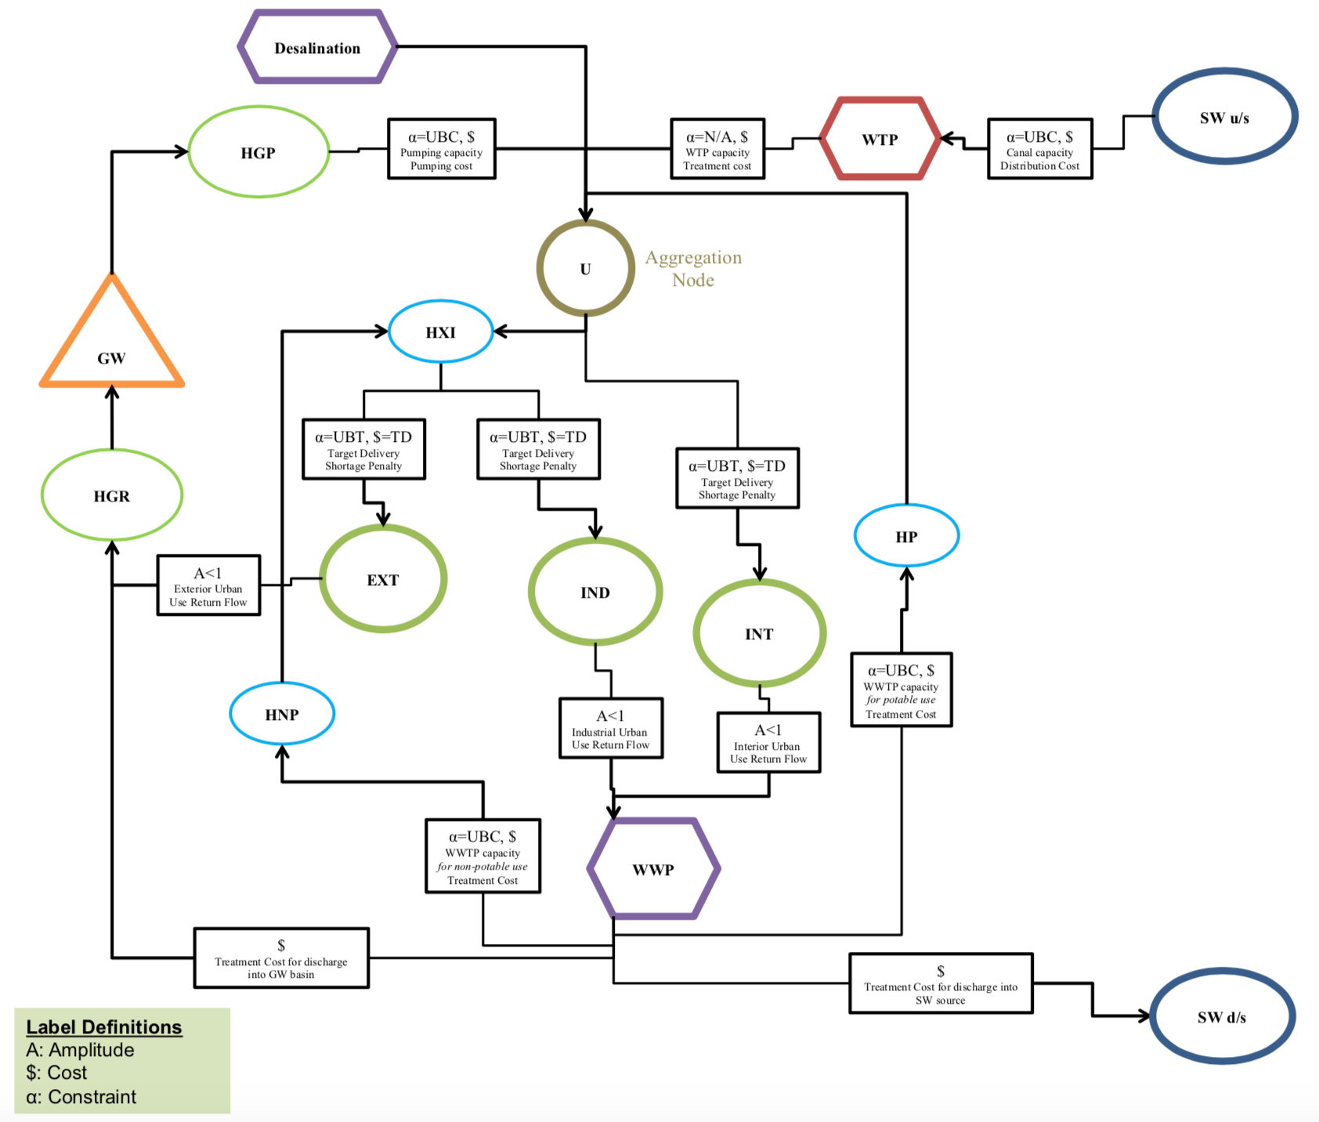
Urban demand
Interior & exterior residential, & industrial demands
Water sources:
Surface water
Groundwater
Desalination
Potable & non-potable recycled water

Slide 36
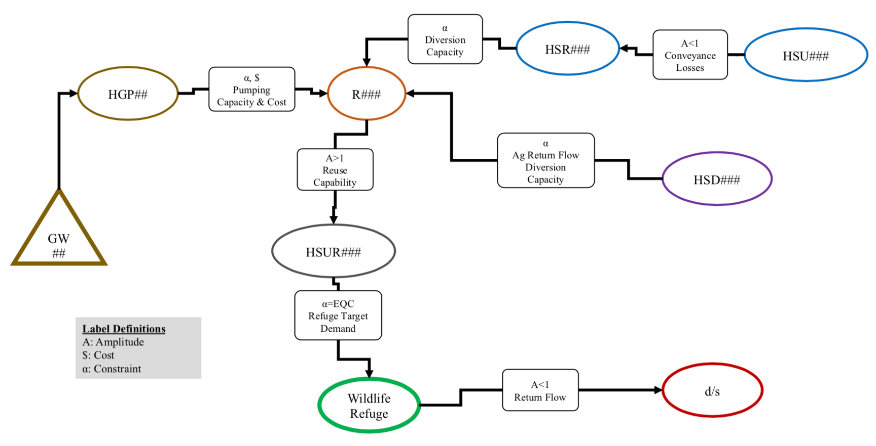
Wildlife refuge demand
9 wildlife refuge demand locations
No economic representation
Constrained water deliveries
Supply sources:
Surface water
Groundwater
Agricultural return flow

Slide 37
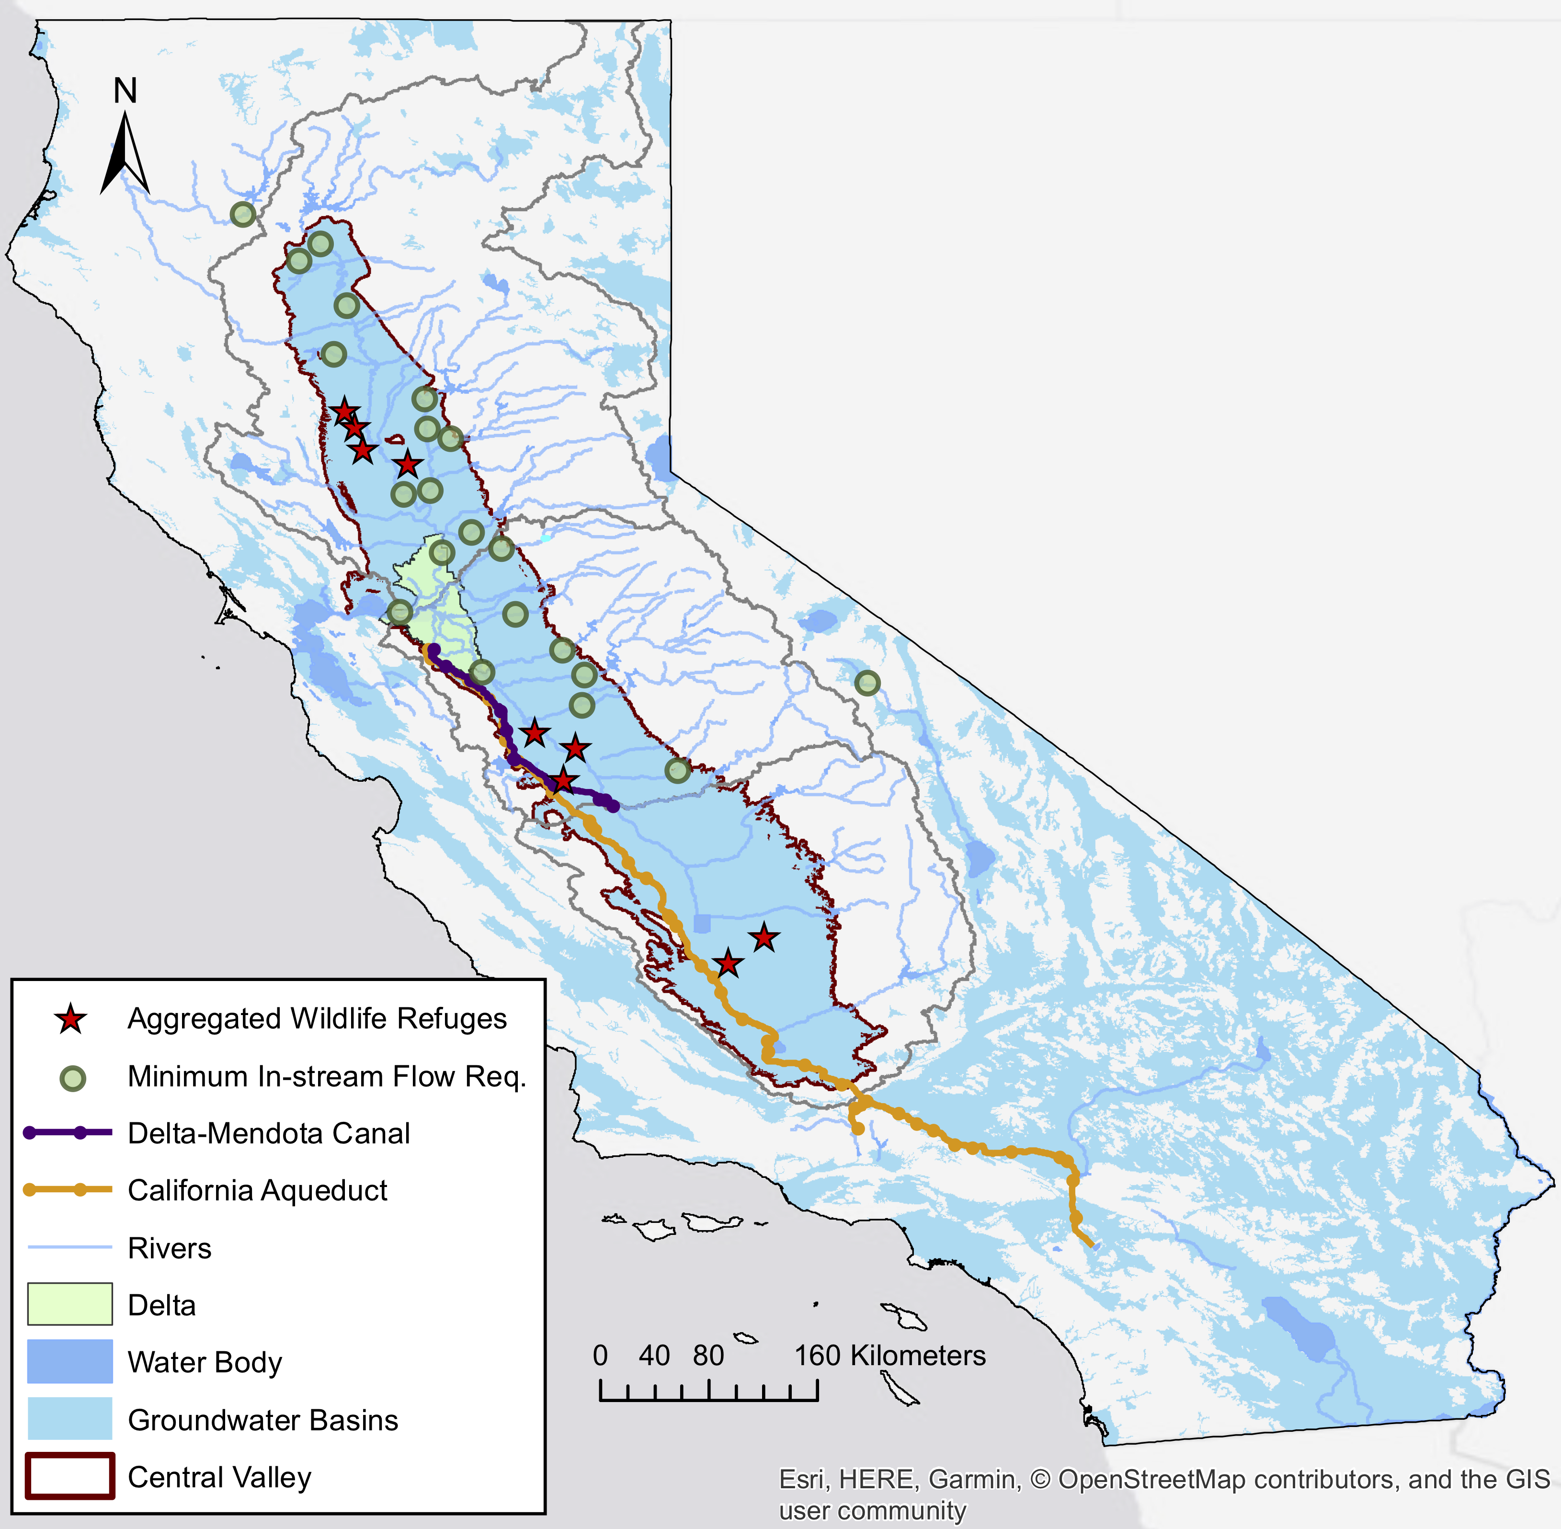
MIF Requirements
Minimum in-stream flow requirements due to aquatic habitat needs
Represented as lower bound constraints
Time-series obtained from CALSIM III model

Slide 38
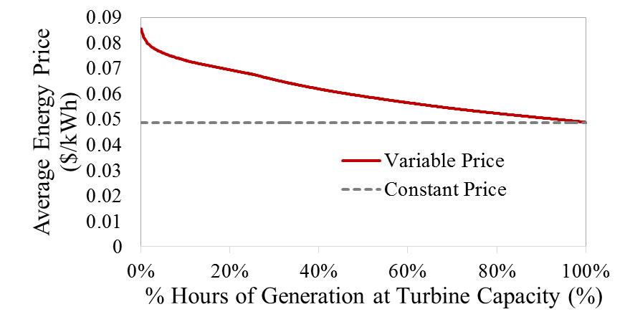
Hydropower
Monthly hydropower operations
Penalty for not generating hydropower (reverse of a benefit curve)
Represented on reservoir storage and release
Hourly average energy prices

Slide 39
CALVIN limitations
CALVIN has several limitations:
Perfect hydrologic knowledge (limited in limited foresight model)
Simplified groundwater representation (unit fixed pumping cost)
Linearized cost curves (piecewise linear)
Simplified hydropower representation due to linear programming (LP) framework

Slide 40
Lessons from CALVIN
CALVIN results show that
Regional or statewide markets can reduce water scarcity costs
Environmental flows have economic values for agricultural and urban and hydropower activities
Economic values exist for expanded facilities
Some scarcity is optimal
Integrated local, regional, and statewide operation of water decreases competition with environmental uses (water trading)

Slide 41
CALVIN goals
The recent updates aims to
Create a cross-platform model: MacOS, Windows
Use open data format: csv, JSON
Have freely available: data, code, modeling language & solvers are open-source or free of charge
Separate model & data:
HOBBES is independent from any data
CALVIN’s structure code is generalized (can solve any other network-flow problems)

Slide 42
CALVIN improvements
The original CALVIN uses HEC-PRM to solve its optimization problem
With recent updates, CALVIN is moved to Python
Pyomo library, a high level optimization modeling language in Python, is used
Pyomo can connect to several freely available solvers
Runtime is decreased from 2-5 days to 30min-1 hr, with parallelization in Pyomo.

Slide 43
HOBBES database
https://cwn.cws.ucdavis.edu
A web-based open-source data storing and sharing platform
Stores California’s water network data
Documentation and change tracking via GitHub
Data visualization and animation
Several models can be built around HOBBES, where built-in tools convert and export network data in the desired format
HOBBES
Database
CALVIN
HEC-PRM
CALVIN
Python version
Water-Energy
network-flow
Other models
...

Slide 44
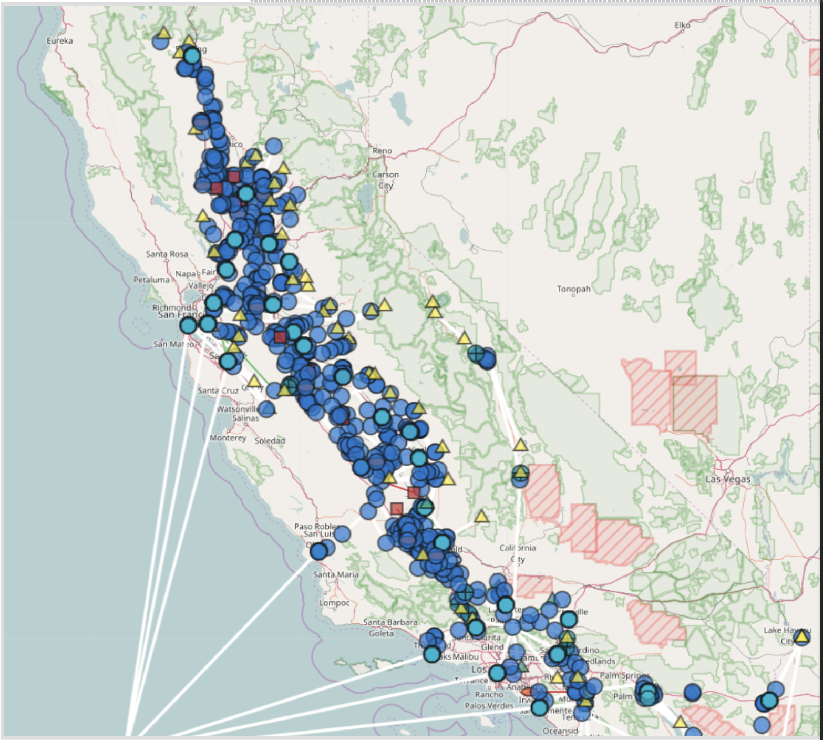
HOBBES visualization
California water network
Geocoded network elements
Layered based on hydrologic regions and subregions
Data visualization
Animation tool
https://cwn.cws.ucdavis.edu

Slide 45
HOBBES for CALVIN (Python)
CALVIN Python version uses matrices for all parameters: c, a, l, u
Calvin-network-tool in HOBBES converts input data into a network matrix
The network matrix is input to CALVIN (Python)
Each of network matrix lines correspond to a link – decision var. (full size model has 6 millions)
i | j | k | c | a | l | u

Slide 46
Network-flow model
CALVIN represents the physical system with nodes and links
Nodes represent reservoirs, demand locations, power and pumping plants and junctions
Links only connect nodes to each other
All network parameters are applied to links: amplitude (loss factor) a, unit cost c, lower bound l, & upper bound u

Slide 47
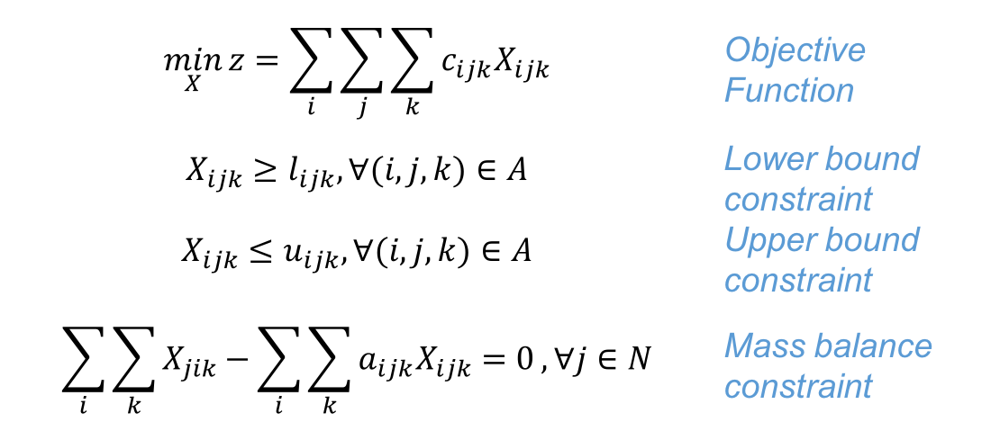
Linear Programming model
As an network-flow LP model, CALVIN minimizes statewide water scarcity and operating costs within constraints
$$\min_{X}{z=\sum_{i}{\sum_{j}{\sum_{k}{c_{ijk}X_{ijk}}}}}$$ | Objective Function
$$X_{ijk}≥l_{ijk}, ∀(i,j,k)∈A$$ | Lower bound constraint
$$X_{ijk}≤u_{ijk}, ∀(i,j,k)∈A$$ | Upper bound constraint
$$\sum_{i}{\sum_{k}{X_{jik}−\sum_{i}{\sum_{k}{a_{ijk}X_{ijk}=0}}}}, ∀j∈N$$ | Mass balance constraint
where X is flow (decision variable); c is unit cost; l is lower bound; u is upper bound; a is amplitude
index i represents origin node; j is terminal node; k is a piecewise component

Slide 48
Resolving infeasibilities
When a mass-balance constraint at any location is not met, the model results in infeasible solution
Due to size of the model, in case of infeasibility, you never know where the problem is
Flow =
100 TAF
Flow =
100 TAF
Capacity =
550 TAF
Lower Bound =
650 TAF
Flow =
500 TAF
Flow =
500 TAF

Slide 49
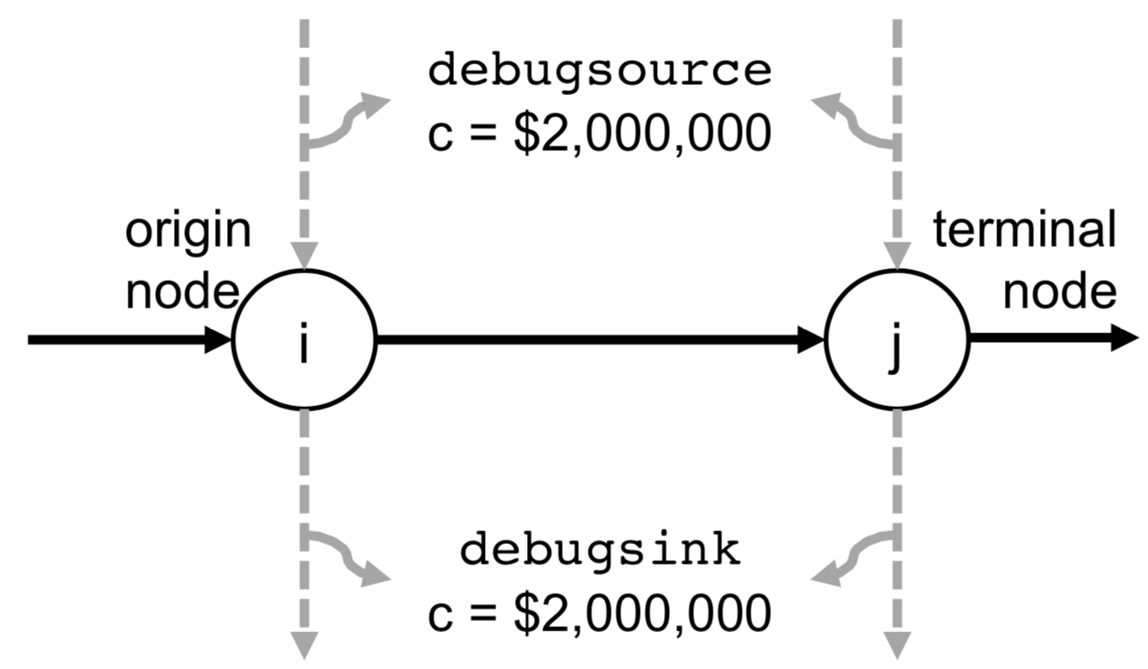
Debug mode
When network is modified (climate change, adding a new requirement or element etc.), first run in debug mode
Debug mode adds two links (debug source & debug sink) at very high cost (~10¹⁰)
The debug cost is much higher than any other cost in CALVIN to make sure it is not used unless there is infeasibility
Then postprocess to
eliminate debug flow
c = $10¹⁰
c = $10¹⁰

Slide 50
CALVIN runtime
Solver wall clock runtime for different model sizes
Installed solvers:
GLPK
CBC
Gurobi
CPLEX
Log-log scale: exponential increase of runtime

Slide 51
Recent hydrology updates
1st generation CALVIN: 1921-1993 (72 years)
2nd generation CALVIN: 1921-2003 (82 years)
3rd generation CALVIN: 1921-2015 (94 years)
The more period, the more floods and droughts, the better system representation
Input hydrology
2nd generation: CALSIM II model
3rd generation (updated): CALSIM III model

Slide 52
Updated components
Sacramento River at Shasta unimpaired rim inflow
Rim inflows
Groundwater inflows
Local inflows
Reservoir evaporation
Environmental demand
Min. instream flow req.
Req. Delta outflow
Wildlife refuge demands
Groundwater subbasin-4 net monthly recharge
Shasta Lake reservoir evaporation rate
SJR at Vernalis minimum instream flow requirements

Slide 53
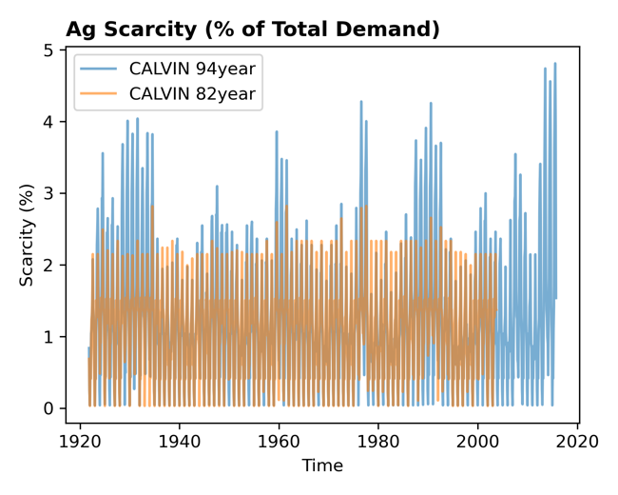
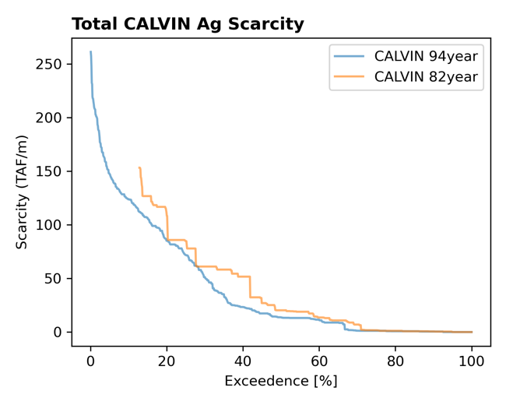
Comparing V2 and V3 CALVIN
Agricultural scarcities increase in drought years
On average, less scarcity in updated CALVIN
Drought years

Slide 54
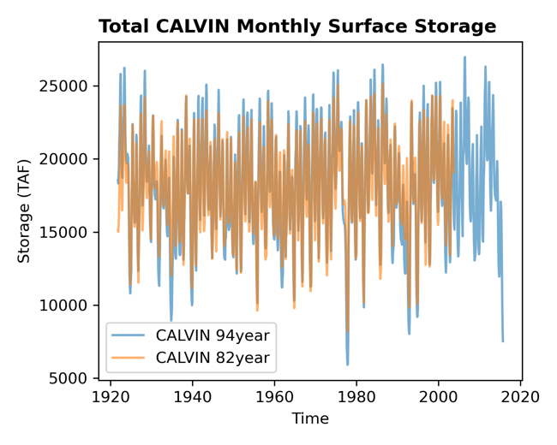
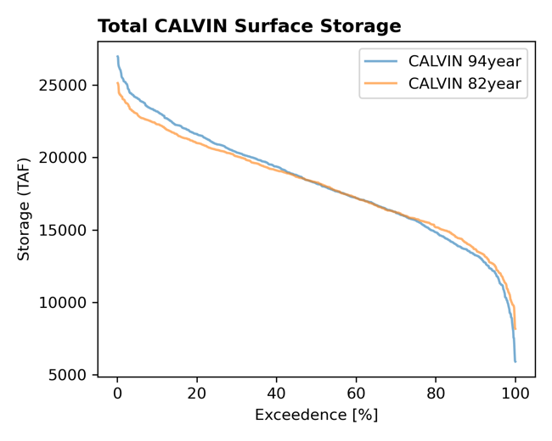
Comparing V2 and V3 CALVIN
Surface storage variability slightly increase
Mean storage remains the same
mean storage
50% of time

Slide 55
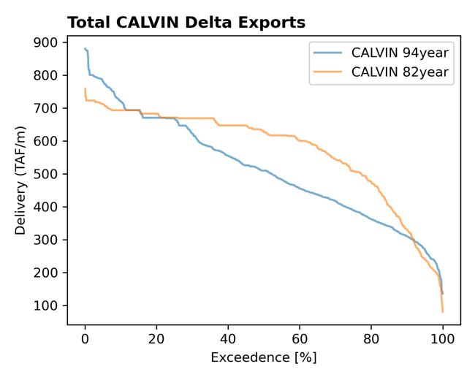
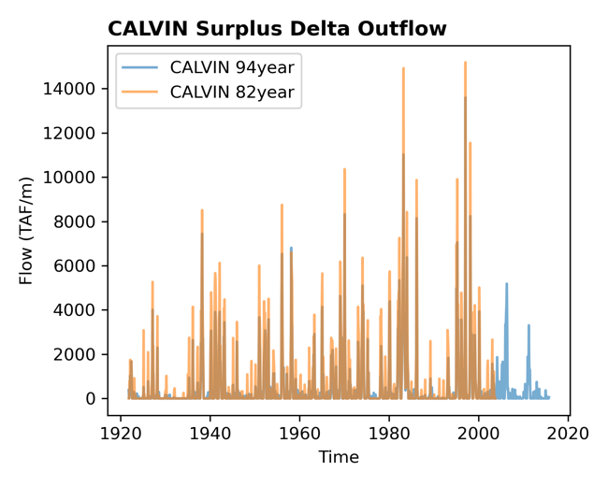
Comparing V2 and V3 CALVIN
Delta exports (CAA & DMC)
Banks PP allowable pumping capacity (reduced)
Surplus Delta outflow decrease
Wet years
mean export
50% of time

Slide 56
Remaining updates/issues
Demand curve updates (agricultural and urban)
Improving data quality for groundwater inflows
Graphical user interface
Network modification documentation
Generic postprocessors to organize and visualize CALVIN outputs

Slide 57
A small network example
Modeling of a reservoir with following properties
Two time-steps

Slide 58
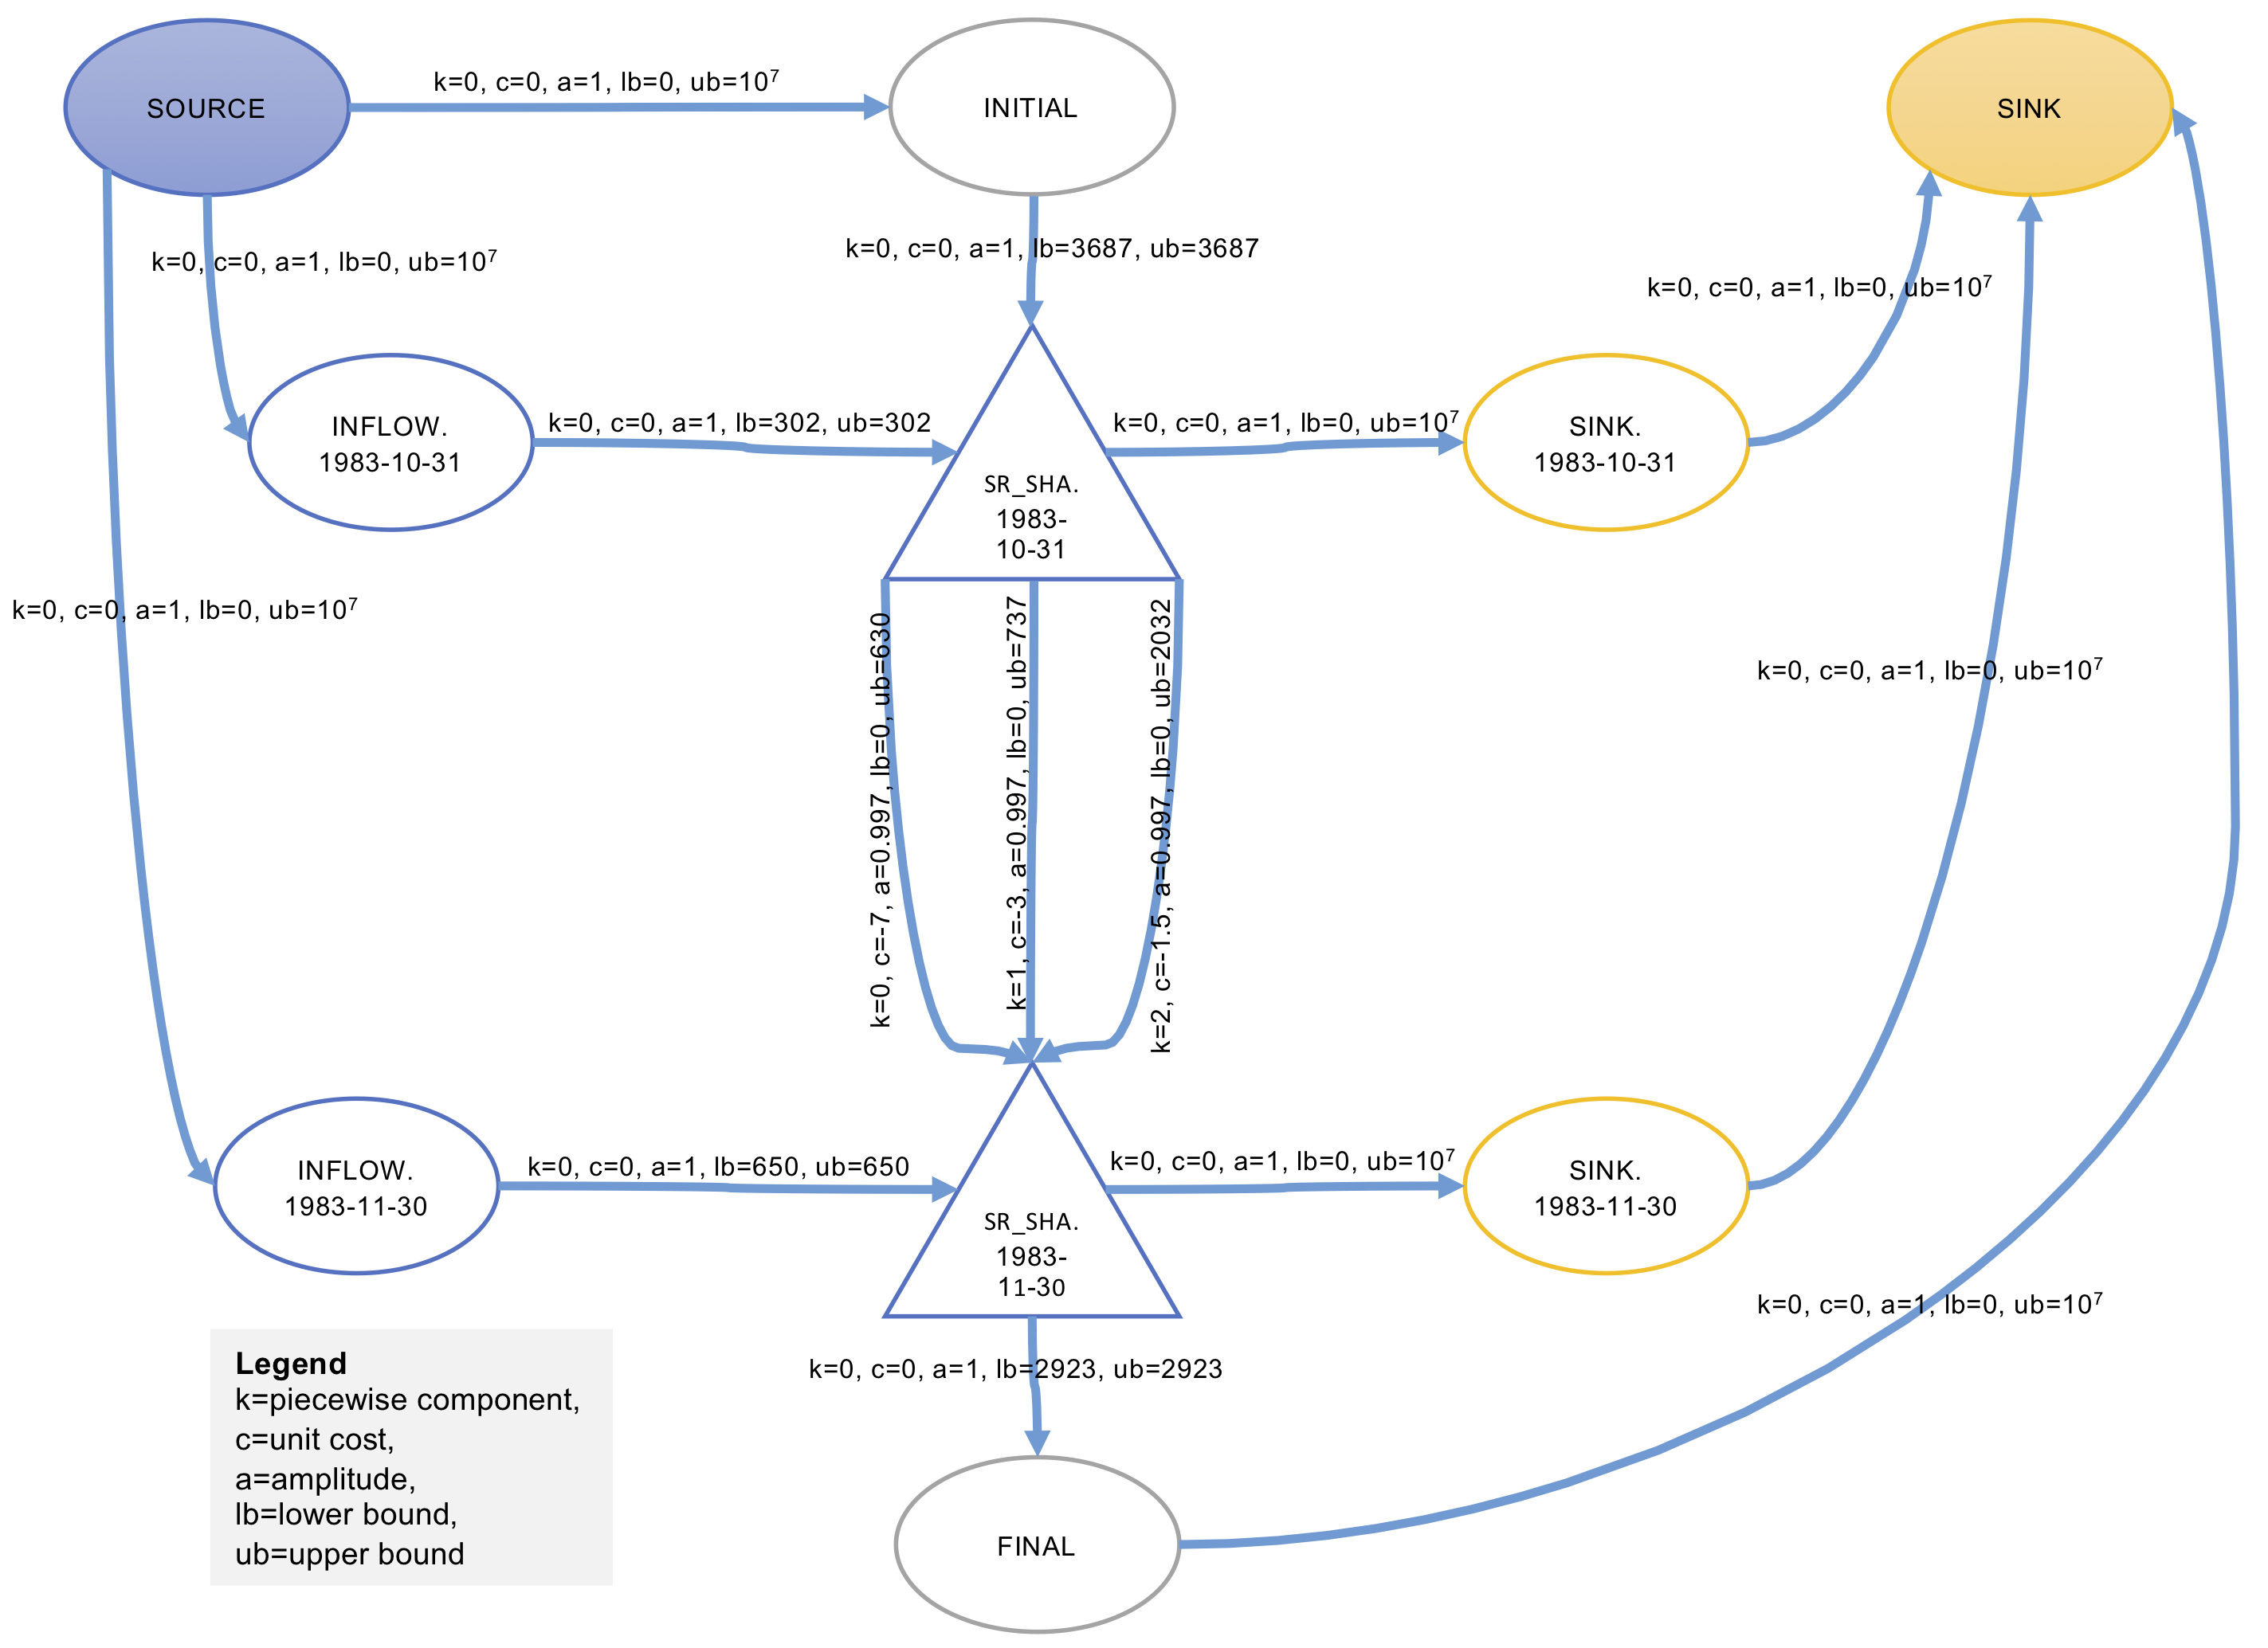
Network-flow form

